Slide 1

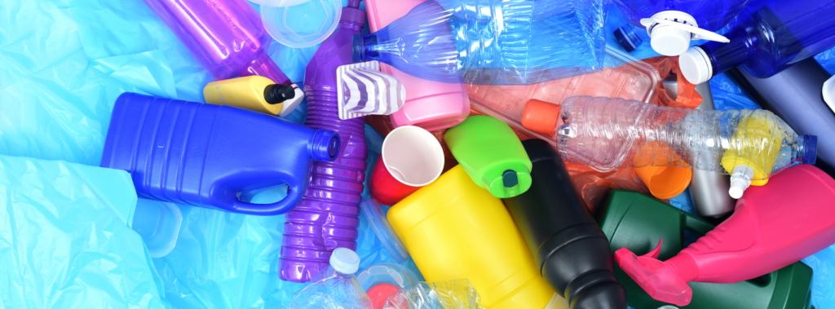
UNIT-II

Slide 2
INTRODUCTION:
Polymers are an crucial part of everyone's life style.
They have diverse applications ranging from domestic articles to complicated scientific and medical instruments.
Fibres, Rubbers, Plastics, Adhesives and Paints are some of Polymers.
Carbohydrates, Proteins, Fatty acids, Lipids and Nucleic acids are some of Biopolymers.
So these materials have penetrated into almost all the applications like transport, agriculture, construction, education etc.

Slide 3
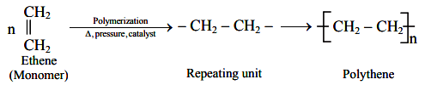
A long molecule formed by joining together of thousands of small molecular units by chemical bond is Polymer.
Due to large size also called as macromolecules.
Due to complex structure also called as Giant molecules.
Small molecules which combine with each other to form polymer molecules are called Monomers.
The chemical process leading to the formation of polymer is called Polymerization.
Number of monomeric units combined in the polymer is known as Degree of Polymerization.

Slide 4
According to nature of monomers:
Homo Polymers : Polymers formed from only one type of monomers are called home polymers
nA → -(A-A-A-A)n-
nCH2=CH2 → (—CH2—CH2—)n
(ethylene) (Polyethylene)
Co polymers : Polymers formed from 2 or more than 2 different types of monomers are called as co polymers.
  Depending upon the structure, co polymers are divided into four types
A. Random co – polymers B. Alternate co – polymers
C. Block co – polymers D. Grafted co – polymers

Slide 5
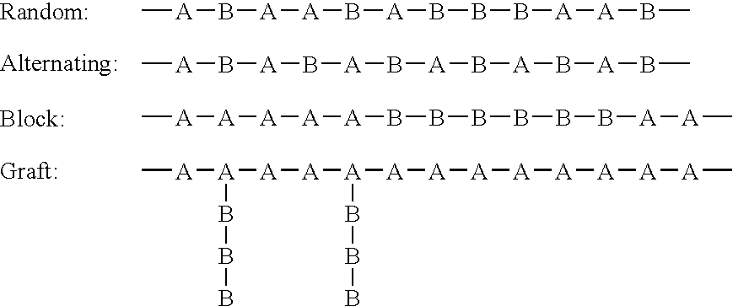
Copolymer:

Slide 6
Biodegradable and Non-biodegradable Polymers:
Polymers which can be decomposed easily by nature are Biodegradable polymers.
Biodegradable polymers are a specific type of polymer that breaks down after its intended purpose to result in natural by-products such as gases (CO₂, N₂), water, biomass, inorganic salts
  Ex: Starch, cellulose, Carbohydrates
  Polymers which cannot be decomposed are called Non-biodegradable (or) Durable Polymers.
  Ex: Mostly all

Slide 7
According to ultimate form and end use of polymer
Based on ultimate form and end use of the polymer. These are divided into following types.
Plastics
Thermoplastics ( Ex: PE, PP, PVC, Nylon)
Thermoset plastics (Ex: Bekalite, Epoxy)
Elastomers (or) rubbers (Ex: Natural rubber, Buna-S, Buna-N)
Fibres (Ex: Polyester, Nylon)

Slide 8
Polymerization
The chemical process by which the monomer molecules are linked to form a polymer is called as “Polymerization”
Addition polymerisation
Addition of repeated monomer molecules possessing double or triple bond, without the elimination of any small molecule is called addition polymerization.
Condensation polymerization
Addition of repeated monomer molecules possessing functional groups, with the elimination of any small molecule is called condensation polymerization.

Slide 9
Addition (chain growth) polymerization:
Monomers must have either a double bond or triple bond.
It results in no by-products.
The addition of monomers results in the formation of the polymer.
The molecular weight of the resultant polymers is a multiple of the monomer’s molecular weight.
In this a chain reaction adds new monomer units to the growing polymer molecule one at a time through double or triple bonds in the monomer so called chain-growth.
Lewis acids or bases, radical initiators are catalysts, in addition, polymerization
Common examples of addition polymerization are PVC, polyethene, Teflon etc.

Slide 10
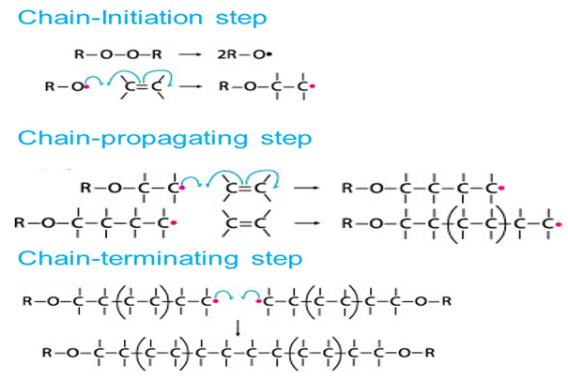

Slide 11
Condensation (Step Growth Polymerisation):
Monomers must have two similar or different functional groups.
It results in by-products such as ammonia, water and HCl.
The condensation reaction between monomers results in the formation of the polymer.
The molecular weight of the resultant polymer is not a multiple of the monomer’s molecular weight.
Different molecules are used as catalysts in the process of condensation polymerization.
In this the growing chains can react with each other to form longer chains. This holds true for chains of all lengths. But in an addition polymerization, only the monomers can react with growing chains.
Common examples of condensation polymerization are nylon, Bakelite, silicon, etc

Slide 12
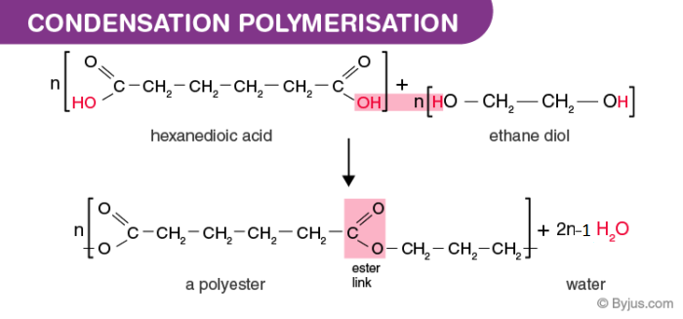
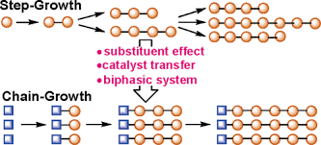

Slide 13
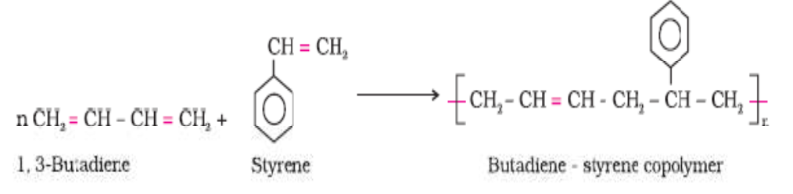
Copolymerization
It is a polymerisation reaction in which a mixture of more than one monomeric species is allowed to polymerize and form a copolymer.
The copolymer can be made not only by chain growth
polymerisation but by step growth polymerisation also.
It contains multiple units of each monomer used in the same polymeric chain.

Slide 14
Addition polymerisation | Condensation polymerisation
1. It is also known as chain growth polymerisation 2. It takes place only in monomers having multiple bonds 3. It takes place without elimination of simpler molecule 4. High molecular weight polymer is formed soon. 5. The product obtained by this Polymerization is thermoplastic. 6. Long reaction time give high yields, but molecular weight of polymer is affected slightly. 7. Polyethylene, polystyrene, polypropene, polyvinyl chloride etc. are its examples | It is also known as step growth Polymerization 2) It takes place in monomers having reactive functional groups. 3) It takes place with elimination of simple molecule like H2O, NH3, HCl etc. 4) The molecular weight of polymer increases steadily throughout the reaction. 5) The product obtained in the polymerisation may be either thermoplastic or thermosetting plastic 6) Long reaction times are essential to obtain high molecular weights 7) Bakelite, urea formaldehyde resin, epoxyresins, etc. are its examples

Slide 15
Plastics
Plastic is property of material which deformed without rupture by the action of a force, and remain deformed after the force is removed.
Thermoplastics | Thermosets
These resins become soft on heating and rigid on cooling reversibly The heating and cooling don't alter the chemical nature of these resins because the changes involved are purely of physical nature. These are formed by addition (or) condensation polymerization They consist of long linear chains with weak vander waal’s forces of attraction between them. They are softened on heating readily because the weak forces of attraction between the individual chain can break easily by heat, pressure or both. They can be reshaped weak and less brittle These resins are usually soluble in organic solvents Ex: Polyethylene, polyvinyl chloride are the examples. | Don’t soften on heating and moulded once. On heating, extensive cross-link is formed in these polymers between the polymeric chains and, thus, they become hard These are formed by condensation polymerization They consist of chains with three dimensional strong cross- linked network structure. The bonds retain their strength on heating hence they do not soften again on heating. Cannot be reshaped These are hard, strong and more brittle These resins are insoluble in almost all organic solvents. Ex:Bakelite, Nylons, etc, are the examples.

Slide 16

Polyvinyl Chloride
Synthesis:
The monomer used for the manufacture of PVC is Vinyl chloride. Acetylene on reaction with HCl gives Vinyl chloride. Polyvinyl chloride is obtained by heating vinyl chloride in presence of small amount of benzoyl peroxide or hydrogen peroxide in an autoclave under pressure.

Slide 17
Properties
PVC is a white, odourless and non-flammable brittle solid. It is insoluble in alcohol but slightly soluble in tetrahydrofuran
Flexibility: PVC is a rigid material but it can be plasticized.
Electrical conductivity: PVC is a very good insulator.
Recyclability: PVC is very recyclable, more so than many other plastics.
Heat Resistance: It has poor heat resistance and degradation by loss of HCl begins at 70ºC. Heat stabilizers added to improve heat stability.
Economical efficiency: PVC is the cheapest of large-tonnage polymers providing many products with the best quality-price ratio.
Melting Point: PVC has a melting point at 160⁰C.

Slide 18
Applications
Plasticized PVC is used in flooring or (PVC-U) unplasticized PVC is used in making window frames.
It is used in making sewage pipes and other pipe applications where cost or vulnerability to corrosion limit the use of metal.
Used in construction fields for insulation on electrical wires or in flooring for hospitals, schools, homes, and other areas where a sterile environment is a priority.
It is used in various industries like building, electronics, electrical, automotive, medical and packaging.
PVC fabric is used in the manufacture of aprons shower curtains, raincoats, jackets and sports bags.
It is used in the garden hosepipe and imitation leather upholstery.

Slide 19
Teflon
The chemical name of Teflon is poly-1,1,2,2-tetrafluoroethylene(PTFE).
Synthesis
Tetra flouroethylene Polymerizes at higher temperature and pressure in the presence of free radical initiators or catalysts like per-sulfate or hydrogen peroxide in aqueous media.
n F₂C=CF₂ → -(-CF₂-CF₂-)_{n}-
(Tetra flouroethylene) (PTFE)

Slide 20
Properties
PTFE is a thermoplastic polymer, which is a white solid at room temperature, with high density.
The presence of highly electronegative fluorine atoms, there exist very strong attractive forces between different chains.
These strong attractive forces are responsible for high strength, toughness and softening temperature (327⁰ C) and high density.
PTFE's resistance to Vanderwaals forces means that it is the only known surface to which a Lizard cannot stick. So it has an anti-adhesion ability.
It is a chemical resistance compound, the only chemicals that can affect these compounds are alkali metals.

Slide 21
^{Engineering Applications}
It is used in making waterproof fabric.
It is used in making non-stick cookware.
It is used in making an anti-friction device.
It is used for coating medical appliances (surgical devices).
Due to its high resistance to corrosion, it is used for coating the lining of laboratory appliances.

Slide 22
Bakelite
It is a thermosetting plastic phenol formaldehyde resin, formed from condensation of phenol with formaldehyde.
Synthesis
Firstly two monomers are combined – phenol and formaldehyde in the presence of an acidic (Hydrochloric Acid and Zinc Chloride) or basic (Ammonia) catalyst.
This results in the formation of ortho-hydroxy benzyl and para-hydroxy benzyl alcohols. These products further react to form compounds that are joined to -CH₂ groups by rings to produce Novolac.
When Novolac is repeatedly heated and undergoes cross-linking with another cross-linking agent, commonly hexamethylenetetramine or excess formaldehyde, the polymer, Bakelite is produced.
This reaction is highly exothermic in nature and needs to be conducted under pressure so that the product is hard, rigid, and dense.

Slide 23
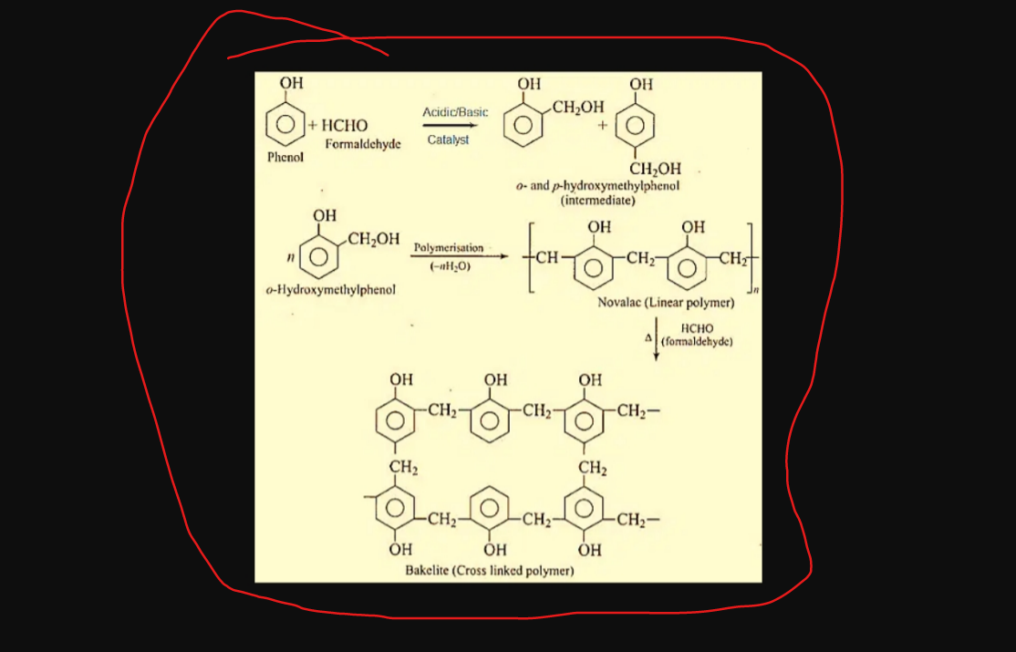

Slide 24
Properties:
Bakelite is a thermosetting plastic. Therefore, when heated, this polymer is malleable. However, when it is cooled, it becomes permanently hard and rigid.
It is a non-conductor of electricity, having a dielectric constant.
It is heat-resistant and therefore, non-flammable. Thus, it functions as a good insulator.
Bakelite is also resistant to any kind of chemical action and hence, is non-destructive.
It can be very easily and quickly molded.
The moldings of Bakelite are fairly scratch-resistant.
It can be found in a variety of colors.
Bakelite has a distinctive fishy odor.

Slide 25
Applications
Bakelite is widely used in the production of various products. Hence, it is rightly known as ‘material of thousand use’.
It acts as a good insulator. It is widely used in making several electrical devices like sockets, automobile distribution caps, switches, insulation wire and non-conducting parts of radios and telephones.
Bakelite can be very easily molded. Thus, it can be used for making a variety of daily-use commodities like clocks, toys, chess, poker chips, buttons.
Since Bakelite is available in a variety of colors, it is also utilized for making artificial jewelry like bangles, earrings, and bracelets.
It is also widely used as adhesives or binding agents and as varnishes or protective coating.
It is also used in making musical instruments like saxophone, whistle, and electric guitar.

Slide 26
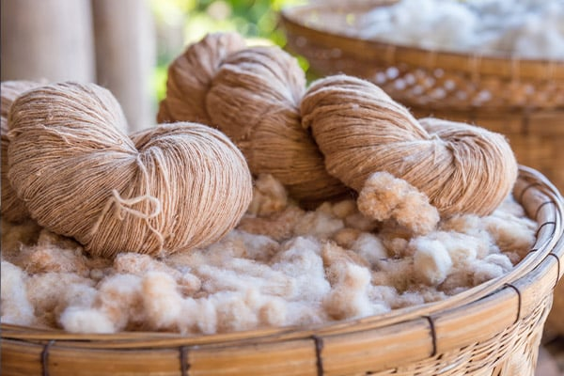
Fibres
Fibres are thread-like structures that are long, thin and flexible. These may be spun into yarns and then made into fabrics.
Natural Fibres
1. Animal fibres: These are obtained from animals.
Wool: Wool is a natural textile fibre obtained from sheep, goats and camels.
Silk: Silk is a natural textile fibre obtained from silkworms. The nurture of silkworms to obtain silk is known as sericulture.
2. Plant fibres: These fibres are extracted from the plants to make fabrics.
Cotton: It is one of the plant fibres. It is found around the seeds in a cotton plant.
Jute: It is a vegetable fibre that is soft, shiny and spun into coarse strong threads.

Slide 27
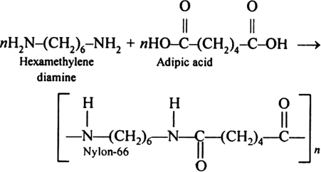
Nylon 6:6 (Polyamide)
Nylon-6:6 belongs to polyamide polymer family that contains recurring amide bonds (R-CO-NH-R) as integral parts of the main polymer.
Synthesis
Equivalent amounts of hexamethylenediamine and adipic acid on heating at 553 K are mixed at 553K under pressure to produce Nylon 6:6.

Slide 28
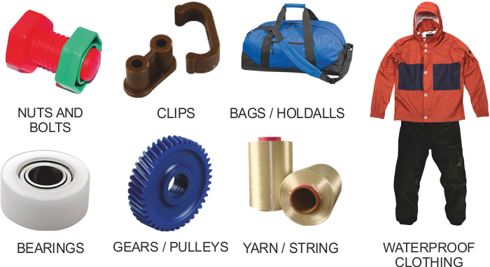
Properties of Nylon 6:6
High mechanical strength.
High toughness, stiffness and hardness.
Good fatigue resistance.
Good impact resistance.
Excellent wear resistance.
Good electrical insulating properties.
No resistance to UV rays.
Lightweight; sometimes used in applications
in place of metals
Uses of Nylon
      Clothing – Shirts, Foundation garments, raincoats, underwear, swimwear and cycle wear.
      Industrial uses – Conveyer and seat belts, parachutes, airbags, nets and ropes, tarpaulins, thread, and tents.
      It is used to make a fishnet.
      It is used as plastic in manufacturing machine parts

Slide 29
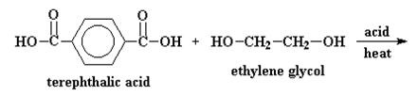
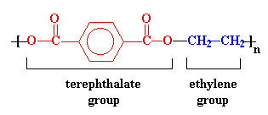
Terylene or Decron or Polyethylene terephthalate (PET):
Decron is a polyester family polymer which contain the ester functional group(RCOOR) in their main chain.
Synthesis: Dacron is obtained by condensation of ethylene glycol and terephthalic acid with the elimination of water molecules. The reaction is carried out at 420 – 460 K in presence of a catalyst mixture of zinc acetate and antimony trioxide.

Slide 30
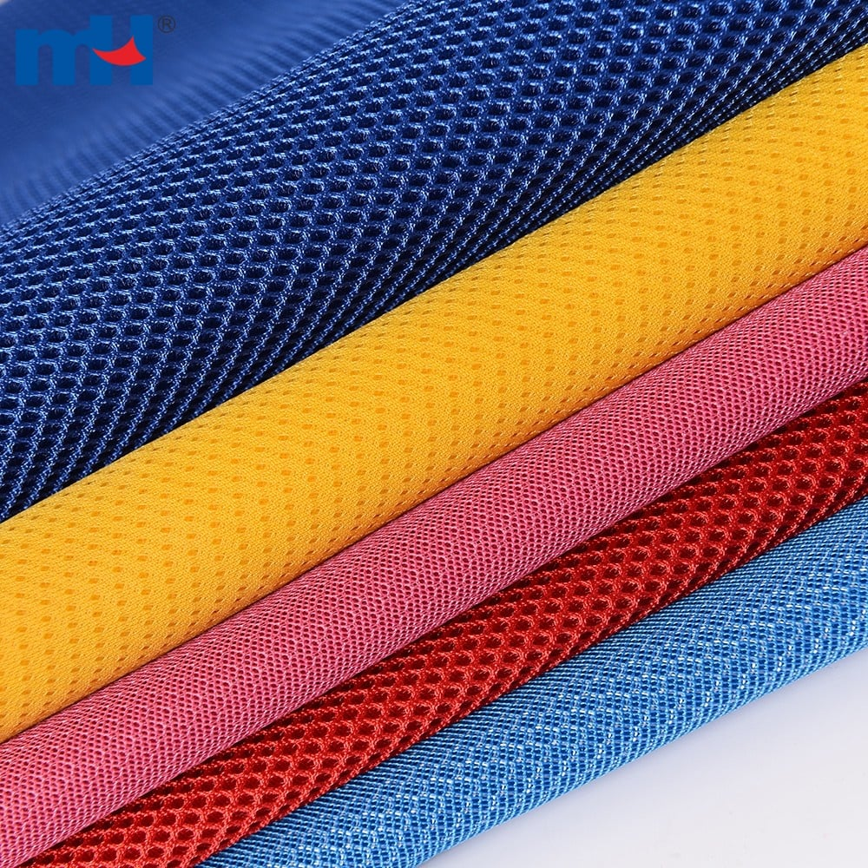
Properties of Terylene:
Terylene is a very strong fibre and will suffer very little loss in strength when wet.
It is elastic in nature and posses the property of resist creasing.
Terylene is easily washed and dries quickly.
It is non-injured by acidic substances. Neither bleaches or dry cleaning agents can harm it.
Use of Terylene:
Terylene is mainly used in making plastic bottles and clothing.
It is also used for making-Terylene fiber is used as polyester tricot knit as a fashion garments fabric.
Used for the laundry usage as a automatic clothing vacuum packaging machine.
It is used to make nonwoven needle punched carpet particularly for the exhibition use.

Slide 31
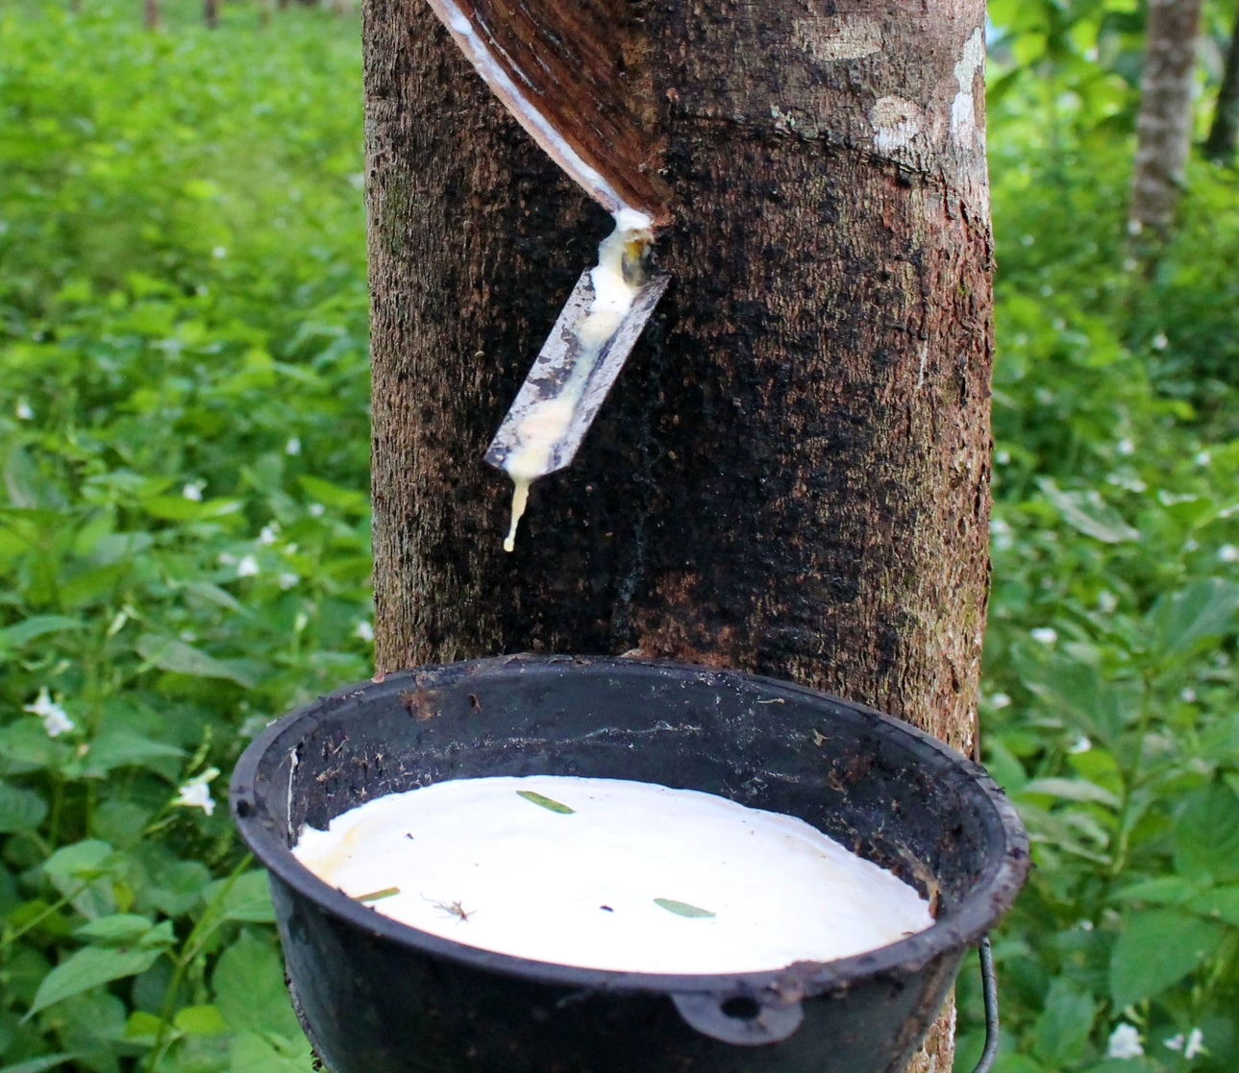
Rubber
Rubber is an elastomer that can be obtained either naturally (natural rubber) or can be chemically produced in a laboratory (synthetic rubber).
Natural rubber
Natural rubber is manufactured from rubber latex, which is a colloidal dispersion of rubber in water.
Natural rubber is a polymer of isoprene (2-methyl-1,3-butadiene) is joined together forming long polymer chain of cis-1, 4-polyisoprene which is also known as natural rubber.

Slide 32
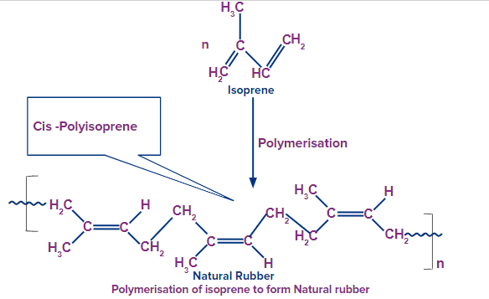
Synthesis of Natural Rubber

Slide 33
Properties of Natural Rubber
Natural rubber is highly elastic, meaning it can stretch and return to its original shape without permanent deformation.
It is a resilient material that can withstand repeated stress, wear, and tear.
It exhibits good resistance to a wide range of chemicals, including acids, alkalis, and solvents.
It has a high degree of water resistance
It has excellent electrical insulating properties
It has moderate heat resistance
It is a renewable and biodegradable material, making it environmentally friendly.

Slide 34
Applications of Natural Rubber
Natural rubber is widely used in the automotive industry to produce tires, belts, hoses, gaskets, and other rubber components.
It is used in a variety of consumer goods, such as gloves, footwear, balloons, toys, and sports equipment.
It is used in various industrial applications, including conveyor belts, hoses, seals, and anti-vibration mounts.
It is used in the construction industry for applications such as sealants, adhesives, and roofing materials.
It is used in electrical cables, insulation materials, and electrical gloves due to its excellent electrical insulating properties.

Slide 35
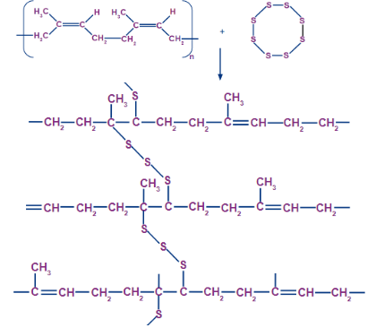
Vulcanization of rubber
Vulcanization consists of heating the natural rubber with sulphur at about 373 K to 415 K. This results in the formation of sulphur bridges between the polymer chains. Sulphur act as a cross-linking agent.
The mechanical properties like tensile strength, elasticity and abrasion resistance of natural rubber can be improved by vulcanization.

Slide 36
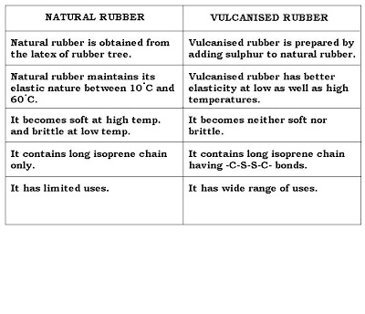

Slide 37

Synthetic rubber
Synthetic rubbers are artificial rubber produced chemically mainly from petroleum by-products and natural gas. Examples of synthetic rubber include Buna-N and Buna-S.
Buna-S:
All so known as styrene rubber or styrene butadiene rubber (SBR) or government rubber styrene (GR-S)
It is obtained by the copolymerization of 1, 3 butadiene and Styrene in the presence of high temperature and sodium catalyst.
It is rigid and resistant to the swelling action of petrol and oils.
It is used in making oil seals, tank linings, etc.

Slide 38
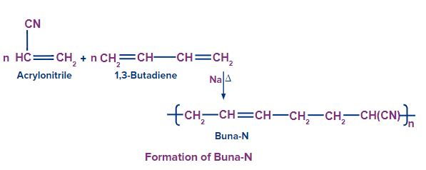
Buna-N:
It is obtained by the copolymerization of 1, 3 butadiene and acrylonitrile in the presence of high temperature and sodium catalyst.
It is rigid and resistant to the swelling action of petrol and oils.
It is used in making oil seals, tank linings, etc.

Slide 39
Properties of Synthetic Rubber
Better abrasion resistance
Good elasticity
Better heat resistance
Better ageing resistance
Electrical insulation material
Flexible at low temperatures
Flame retardant
Resistant to grease & oil etc
Uses of Synthetic Rubber
The transport industry is the largest user of rubber for the production of tires.
Rubber is used by the construction industry in elevator belts, hoses, tubes, seismic bearings etc.
Industries which produce consumer goods use rubber to make good footwear, erasers and sports, etc.

Slide 40
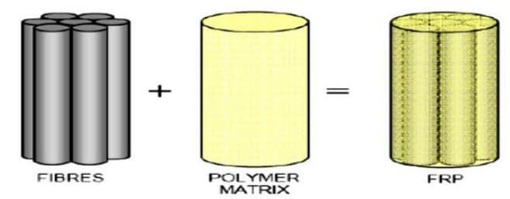
Fiber-reinforced plastics (FRP)
FRP is a composite material made of a polymer matrix strengthened with fibres.
The fibres are usually glass, carbon, aramid, paper, wood or asbestos.
The polymer is usually an epoxy, vinyl ester or polyester thermosetting plastic, and phenol formaldehyde resins.
FRPs are commonly used in the aerospace, automotive, marine, and construction industries

Slide 41
Applications of FRPs
FRPs are used to make aircraft and spacecraft structural parts.
These are used to make printed wiring boards.
These are used for flooring, siding, roofing, restrooms, and pergolas.
They are also used to make agricultural buildings, such as fertilizer and machinery storage sheds.
FRPs are used in ballistic armor and cylinders for self-contained breathing apparatuses.
FRPs are used to make racquets, hockey sticks, bike frames, fishing rods, surfboards, and more.
FRPs are used to replace certain metal, wood, and fiberglass components in firearms.
FRPs are used to make high-performance drones and other remote-controlled vehicles and aircraft components.

Slide 42
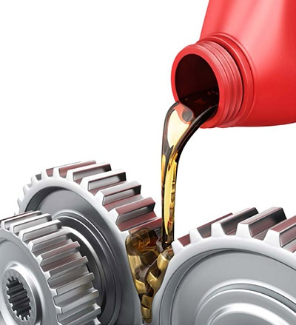
Lubricants
A lubricant is a substance, reduce friction between surfaces in mutual contact
The property of reducing friction is known as lubricity.
Lubrication is the process or technique of using a lubricant to reduce friction between two surfaces.
Lubricants can be solids, solid-liquid dispersions, liquids, liquid-liquid dispersions or gases.

Slide 43
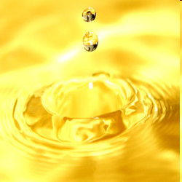
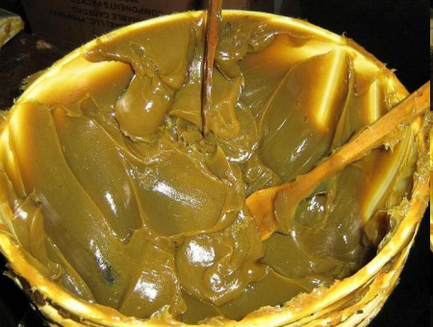
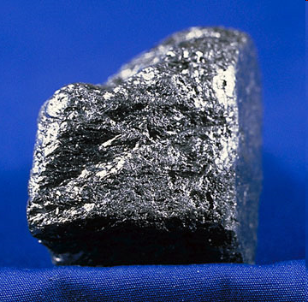
EXAMPLES
Classification of Lubricants
Liquid Lubricants: Mineral Oil or Petroleum Oil, Animal or Vegetable Oil, Blended oil etc.
Semi Solid Lubricants or Greases: Calcium based greases, Soda-based greases, Lithium-based greases, Axle greases
Solid Lubricants:
Graphite, MolybdenumDisulphide etc.

Slide 44
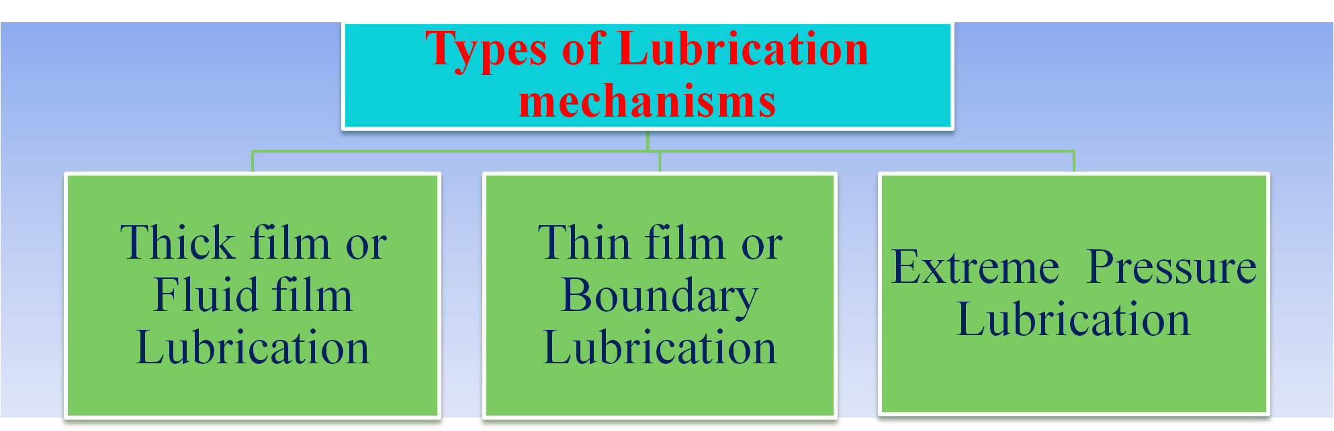
This is based on the extent to which the contacting surfaces are separated in a shaft bearing combination.

Slide 45
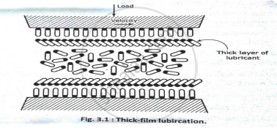
Thick Film or Fluid Film or Hydrodynamic Lubrication
It is carried out with the help of liquid lubricants.
In this mechanism, two moving and sliding surfaces are separated by thick film of lubricant fluid of about 1000A°, applied.
So it prevents direct surface to surface contact and consequently reduce wearing and tearing of metals.
Therefore it is known as thick film or fluid film lubrication or hydrodynamic (hydro meaning liquid and dynamic meaning relative motion) lubrication
In this case fluid is formed by mixing of hydrocarbon oils and anti-oxidants with long chain polymer so as to maintain viscosity.
Fluid film lubrication is useful in delicate and light machines like watches, clocks, guns, scientific equipments.

Slide 46
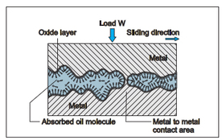
Thin Film or Boundary Lubrication
This is applicable when thick film cannot persist and direct metal to metal contact is possible due to high load, low viscosity.
It is carried out with semi-solid and solid lubricants
A thin layer oil of lubricant of which gets adsorbed by physical or chemical means on metallic surfaces.
The whole load is carried by the layers of adsorbed lubricant, thus, preventing the direct contact between the two surfaces.
The lubricant chosen should possess active groups or atoms which can form chemical linkages of metal surfaces with long chain hydrocarbons .
The lubricants used are vegetable oils, animal oils, glycerides of higher fatty acids, mineral oils with added oiliness carriers.

Slide 47
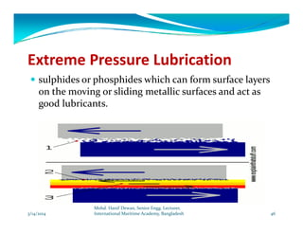
Extreme Pressure (or Temperature) Lubrication
In this mechanism, moving or sliding surfaces are under high pressure and speed, so this is called extreme pressure lubrication.
In such a case high temperatures generated due to friction, so liquid lubricants are fail to stick and decompose or vaporize.
These problems are minimized by special additives are added to mineral oils.
These additives form durable films on metal surfaces which can withstand high loads and high temperatures.
Important additives are organic compound having group like chloride, sulphur, phosphorus etc.
They react with metallic surface to form metallic compound (possess high melting points and serve as good lubricants under extreme temperatures and pressures) like chlorides, sulphides, phosphate as more durable film.

Slide 48
Properties of Lubricants
Viscosity and Viscosity index
Viscosity is the property of a fluid that determines its resistance to flow.
It is an indicator of flow ability of lubricating oil. The lower viscosity greater will be the flow ability.
If temperature increases viscosity of the lubricating oil decreases and pressure increases viscosity of lubricating oil increases.
In short we can say that good lubricating oil is that whose viscosity does not change with temperature.
Viscosity index of a lubricating oil is defined as measure of change in viscosity with temperature.
High viscosity index means low change in viscosity with temperature.
Therefore, a good lubricating oil must possess as high viscosity index as possible.

Slide 49
Flash and Fire point
The flash point of an oil is the lowest temperature at which it gives off vapours that will ignite for a moment when a small flame is brought near it.
The fire point of an oil is the lowest temperature at which the vapours of the oil burn continuously even after the source of ignition is removed.
These measurements are to assess the safety hazard of a lubricants with regard to its flammability.
This is then used to warn of a risk and to enable the correct precautions to be taken when using, storing or transporting the liquid.

Slide 50
Cloud and Pour Point
Cloud point of an oil is the temperature at which the lubricant becomes cloudy or hazy when cooled.
Pour point of an oil is the temperature at which the lubricant just cease to flow when cooled.
Cloud point and pour points indicate the suitability of lubricants in cold conditions.
Lubricants used in a machine working at low temperature should possess low cloud and pour points.

Slide 51
Aniline point and Acid value
Aniline point of a lubricating oil is defined as the temperature at which equal volumes of aniline and lubricating oil are completely miscible.
Low aniline point means high percentage of aromatic hydrocarbons in the oil. It should be as high as possible, because aromatic hydrocarbons dissolve and deteriorate the rubber seals.
The acid value of an oil is a measure of the amount of free fatty acids (FFAs) in the oil, and is expressed as the number of milligrams of potassium hydroxide (KOH) needed to neutralize the free fatty acids in one gram of oil.
The acid value is a relative measure of rancidity because free fatty acids are formed when triglycerides decompose.
An increase in acid value indicates that the oil is oxidizing, which can lead to gum and sludge formation, as well as corrosion

Slide 52
The lubricant performs the following functions:
Reducing friction: Lubricants reduce friction between moving surfaces.
Preventing corrosion: Lubricants can protect against corrosion by forming a barrier that keeps water away from metal surfaces.
Improving performance: Lubricants can improve the reliability and performance of equipment.
Removing contaminants: Lubricants can remove contaminants from mechanical systems.
Acting as electrical insulators: Lubricants with high dielectric constants can act as electrical insulators in transformers and switchgear.
Freeing seized bolts and nuts: Penetrating lubricants can free rusted or seized bolts and nuts.
Breaking down adhesives and corrosion: Penetrating lubricants can break down adhesives and buildup or corrosion.

Slide 53
A good lubricant has many characteristics, including:
Viscosity: A lubricant with a higher viscosity index is more desirable because it provides a more stable lubricating film over a wider temperature range.
Thermal stability: A good lubricant can maintain its integrity and viscosity even at high temperatures.
Pour point: The lowest temperature at which the oil can still flow like a liquid. Its pour point should be low.
Flash point: The lowest temperature at which a lubricant will ignite when heated. The flashpoint should be higher than the highest operating temperature.
Resistance to oxidation: Good lubricant has high resistance to oxidation and heat.
Non-corrosive properties: A good lubricant has non-corrosive properties.
Stability to decomposition: A good lubricant is stable to decomposition at the operating temperatures

Slide 54
Short answer questions
Write a short note on Copolymers.
Compare biodegradable polymers with synthetic polymers.
Define polymerization.
Differentiate plastics from rubbers.
Write structure of natural rubber.
What is mean by vulcanization?
What is Fiber ? Classify?
Write a note on FRPs.
Compare Cloud point with Pour point.
Differentiate Fire point from Flash point.
Define Aniline point and Acid value.
Discuss properties of Ideal Lubricants.
Write any four applications of given Polymer.
What is viscosity index?

Slide 55
Long answer questions
Compare addition polymerization and Condensation polymerization.
Write mechanism of Addition polymerization.
Write synthesis, properties and applications of following polymers
PVC
Teflon
Compare Natural rubber with Vulcanized rubber.
Differentiate Thermoplastics from Thermosetting plastics.
Discuss Thick film and Thin film lubrication mechanism.
Bakelite
Nylon 6:6
Decron
Buna- S

